Slide 1
Search in sorted matrix
2023/02/03
Hailey

Slide 2
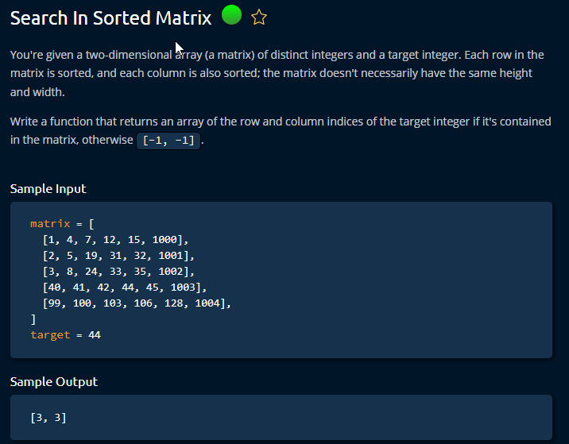

Slide 3
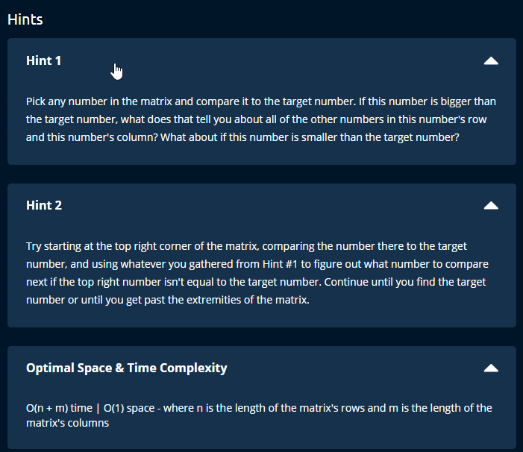

Slide 4
Steps
Matrix is a two dimensional array[ nested list ]
Since it is sorted:
Numbers on the left and up are smaller and those on right and below are smaller.
Any number from the matrix can be chosen as a starting point.
However, there are risks in some positions.
E.g. matrix[0][0] == 1, in that case both next row and column are larger than it, thus by making it face multiple variations. The reverse is true of matrix[-1][-1].
So the best positions are matrix[0,5] and matrix[4,0] .
Then, matrix[4,0] = matrix[row][col] whereas as row = len(matrix-1) and col= 0 in any nested list.

Slide 5
